Slide 1

AI – Assisted Well-being System For People With Mental Health Conditions
f
Reg. No. | Name of the student
BL.EN.U4CSE23126 | J V V Sai Akshay
BL.EN.U4CSE23114 | Challa Vishwa Chaitanya Reddy
BL.EN.U4CSE23118 | D Hari Keerthan Reddy
BL.EN.U4CSE23108 | Amogh Babi
Team_No: 23UG041
Project Advisor: Dr. Sajitha Krishnan
Panel Members: Dr. Ritesh Raj & Dr. Vasavi C S
1

Slide 2
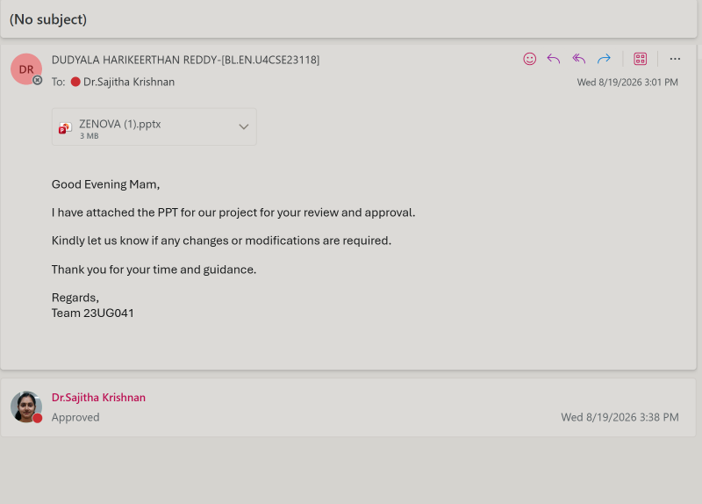
Guide's Approval

Slide 3
Problem Definition
Depend heavily on periodic clinical assessments Limited continuous monitoring of mental-health patterns
Difficulty identifying gradual changes in mood and behaviour
Existing conversational AI systems may produce unsafe or inappropriate responses
Limited integration of conversation, behavioural signals, and longitudinal data
Single-model AI systems often lack safety constraints and clinical explainability
Existing systems provide limited personalized early-warning support

Slide 4
Problem Definition
There is a need for
Continuous and personalized mental-health monitoring
Multimodal AI-based behavioural analysis
Safety-gated conversational support
Early identification of concerning changes
Human-in-the-loop clinical decision support

Slide 5
Mental-health conditions such as anxiety, depression, mood disorders, and stress can significantly affect an individual's daily life, behaviour, and emotional well-being.
Traditional mental-health monitoring:
Requires periodic clinical assessments
May miss gradual behavioural and emotional changes
Provides limited continuous monitoring
This System Addresses This Challenge Using:
Natural Language Processing & LLMs
Multimodal mental-health analysis
Safety-gated conversational support
Introduction

Slide 6
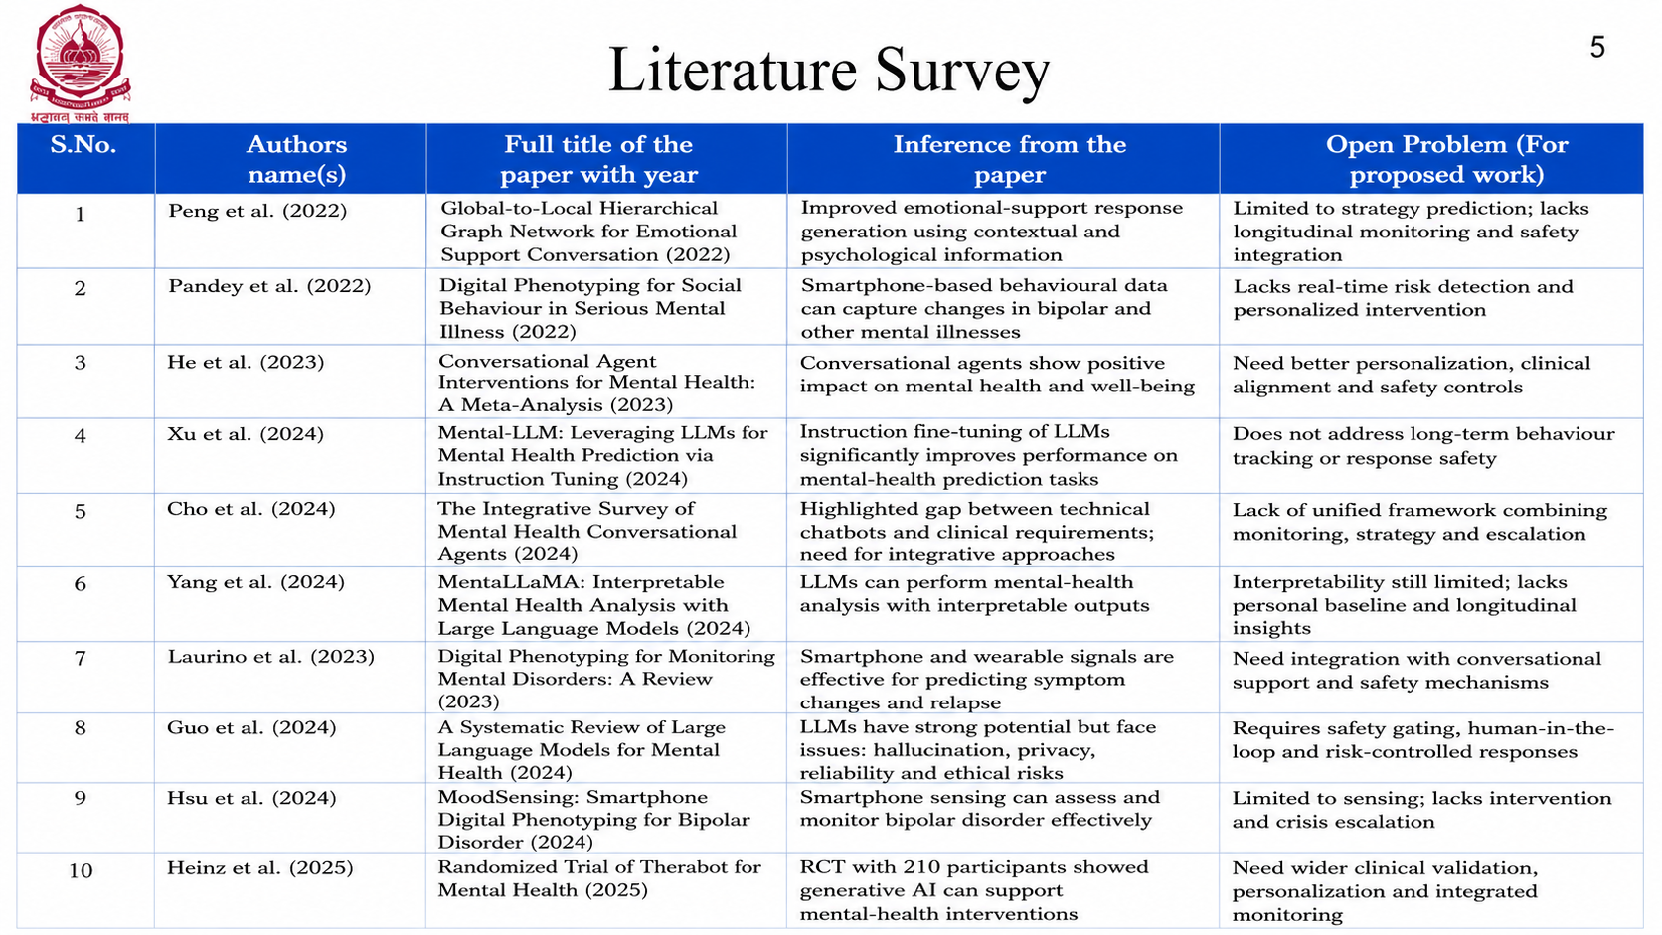
Literature Survey

Slide 7
Objectives
Develop an AI-assisted mental-health support and monitoring platform
Implement a multimodal data processing pipeline for text, voice, self-reports, and optional behavioral signals
Develop NLP/LLM-based conversational support with controlled response generation
Develop a safety-gated strategy planner for selecting appropriate support interventions
Detect significant deviations from individual behavioural baselines
Implement crisis detection and human-escalation mechanisms
Develop ZenovaSafe, an adversarial safety evaluation benchmark
Provide an explainable clinician dashboard for longitudinal mental-health insights
Evaluate the system for accuracy, personalization, safety, reliability, and response quality

Slide 8
Justification for the Proposed Problem
Mental-health conditions can involve gradual changes in mood, behaviour, sleep, and daily routines that may not be captured during periodic clinical assessments.
Existing conversational AI systems can provide accessible support, but may produce unsafe, inappropriate, or overly agreeable responses.
Current digital-phenotyping systems can monitor behavioural patterns, but are often separated from conversational intervention systems.
A personalized baseline can help identify meaningful changes relative to an individual's normal behaviour rather than applying the same threshold to every user.
Mental-health AI requires strong safety mechanisms, human oversight, and explainability before it can be responsibly used.
Combining multimodal monitoring, longitudinal analysis, conversational AI, safety gating, and professional escalation can provide more comprehensive support.
The system proposes a unified framework that connects behavioural changes with safe, personalized conversational support while keeping human professionals in the loop.

Slide 9
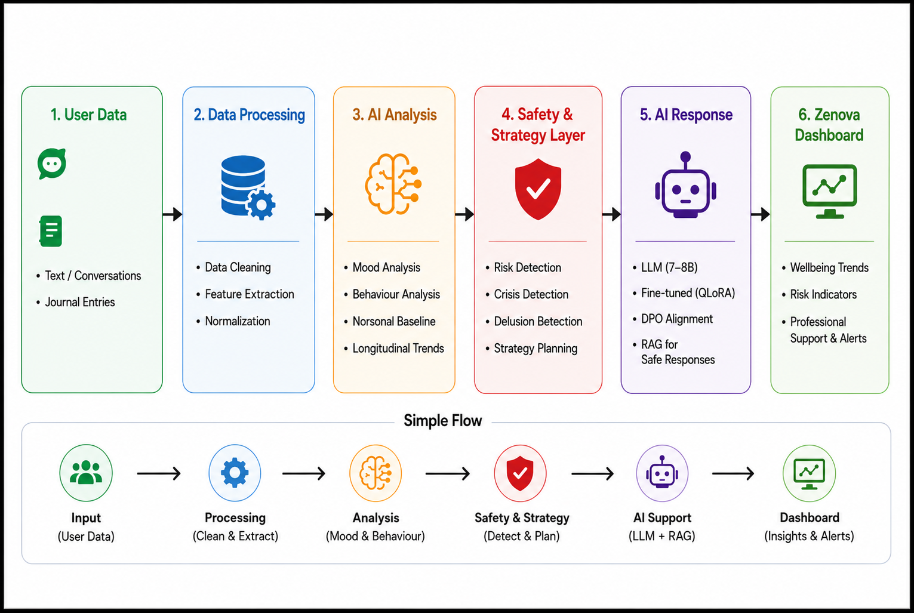
Architecture of the Proposed System

Slide 10
Functionalities of the Proposed System
Module 1 — Multimodal Data Collection
Text & conversations
Journal entries
Optional behavioural signals
Module 2 — AI-Based Mental Health Analysis
Emotion & sentiment analysis
Mood analysis
Behavioural pattern detection
Personal baseline tracking
Module 3 — Safety & Strategy Engine
Risk detection
Delusion detection
Safety checks
Support strategy selection

Slide 11
Functionalities of the Proposed System
Module 4 — AI Conversational Support
Fine-tuned LLM
RAG-based responses
Personalized support
Safe response generation
Module 5 — Zenova Dashboard
Wellbeing trends
Risk indicators
Alerts & professional support

Slide 12
Software / Tools Requirements
Operating System
Windows 10 / Windows 11
Ubuntu Linux
Programming Language
Python 3.10+
Development Environment
VS Code
Jupyter Notebook
AI / ML Frameworks
PyTorch
TensorFlow
Scikit-learn
Data Processing
NumPy
Pandas
SciPy

Slide 13
Software / Tools Requirements
NLP / AI Tools
NLTK
spaCy
PEFT / QLoRA
RAG Framework
Visualization
Streamlit
Plotly
Version Control
Git & GitHub

Slide 14
Datasets
ESConv (Emotional Support Conversation Dataset)
Source: Liu et al., 2021 (ACL)
Size: 1,053 dialogues | 31,410 utterances
Format: Text-only, crowdsourced help-seeker ↔ supporter conversations
Structure: Follows Exploration → Comforting → Action support process
Annotations: Each supporter turn labeled with 1 of 8 support strategies
Question, Restatement, Reflection of Feelings, Self-disclosure, Affirmation/Reassurance, Providing Suggestions, Information, Others
Use case: Trains models on strategy planning — deciding what kind of support to give and when
Limitation: English, text-only, no clinical/diagnostic labels, no voice

Slide 15
Successfully proposed Zenova, an AI-assisted mental-health support and monitoring platform.
Will integrate multimodal data, NLP/LLMs, behavioural analysis, and personalized monitoring.
Will use personal baselines to identify significant changes in user behaviour and wellbeing.
Will Implement a safety-gated strategy layer to control AI-generated responses.
Provides personalized conversational support and early-warning insights.
Will be designed as a clinician-extending system, not a replacement for mental-health professionals.
Provides a foundation for safe, scalable, and personalized mental-health technology.
Conclusion

Slide 16
Advanced AI Personalization
Adapt conversations and recommendations based on the user's past interactions and individual patterns.
Improved Mood & Behaviour Tracking
Analyze long-term changes in mood, sleep, activity, and daily routines using phone-based data.
Voice-Based Analysis
Use voice inputs to identify additional emotional and behavioural patterns.
Multilingual & Code-Mixed Support
Support Indian languages such as Telugu, Hindi, and Kannada, including Hinglish/Kanglish-style conversations.
Enhanced Crisis Detection
Improve detection of crisis-related messages and provide appropriate support and human escalation.
Clinician Dashboard
Allow users to securely share summarized mood and behavioural trends with mental-health professionals.
Explainable AI
Provide understandable reasons behind detected patterns and recommendations.
Personalized Intervention Planning
Adapt the type and timing of supportive activities based on individual user responses.
Continuous Safety Evaluation
Expand ZenovaSafe with more real-world, multi-turn, and culturally diverse safety scenarios.
Cloud-Based Deployment & Scalability
Deploy the application securely on cloud infrastructure to support more users while maintaining privacy.
Future Enhancements

Slide 17
References
[1] Yang et al., MentaLLaMA: Interpretable Mental Health Analysis on Social Media with Large Language Models, WWW, 2024.
[2] Yang et al., Towards Interpretable Mental Health Analysis with Large Language Models, EMNLP, 2023.
[3] Zhang et al., Symptom Identification for Interpretable Detection of Multiple Mental Disorders on Social Media, EMNLP, 2022.
[4] Heinz et al., Randomized Trial of a Generative AI Chatbot for Mental Health Treatment, NEJM AI, 2025.
[5] Moore et al., Expressing Stigma and Inappropriate Responses Prevents LLMs from Safely Replacing Mental Health Providers, FAccT, 2025.
[6] Pichowicz et al., Performance of Mental Health Chatbot Agents in Detecting and Managing Suicidal Ideation, Scientific Reports, 2025.
[7] Adler et al., Machine Learning for Passive Mental Health Symptom Prediction, PLOS ONE, 2022.
[8] Zhang et al., Generative AI Mental Health Chatbots as Therapeutic Tools: Systematic Review and Meta-Analysis, JMIR, 2025.
[9] The Applications of LLMs in Mental Health: Scoping Review, JMIR, 2025.
[10] Most DAIC-WOZ Depression Classifiers Are Invalid, ICMI Companion, 2025.

Slide 18
THANK YOU

